Slide 1
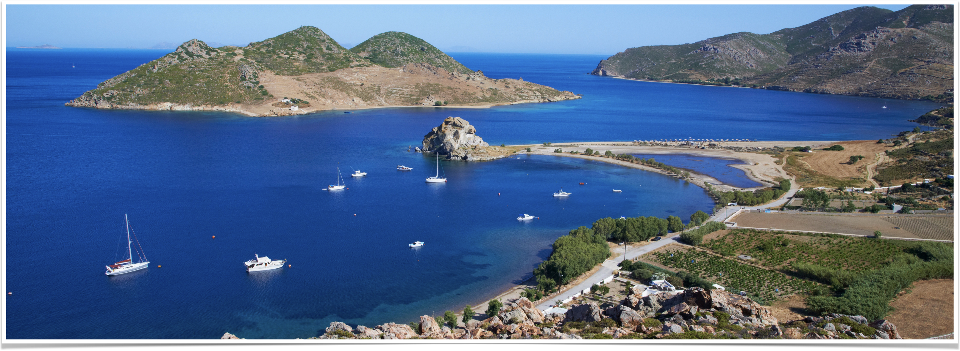
The Revelation of Jesus Christ
Vision 3, Part 5 (Revelation 13:11-15) - The Second Beast

Slide 2
Summary of Revelation 13:5-12
By corrupting God’s design for the church, the Latin church blasphemed God, His church, and those who were martyred for their faith in Jesus.
Secular authorities were urged by the Latin church to root out heresy — anyone who would not submit to the church’s authority was put to death
The church should take to heart God’s warnings and persevere in the face of these trials
The papacy would work together with the Latin church to accomplish its objectives

Slide 3
13:11-12
Then I saw another beast coming up out of the earth, and he had two horns like a lamb and spoke like a dragon. And he exercises all the authority of the first beast in his presence, and causes the earth and those who dwell in it to worship the first beast, whose deadly wound was healed.

Slide 4
Reviewing The Second beast
“…coming up out of the earth” - as opposed to the sea
“…two horns” — two “kingdoms” (remember 17:12)
“…horns like a lamb and spoke like a dragon” - looks like Jesus but talks like Satan
  Matthew 7:15 - wolves in sheep’s clothing
  This is a dragon in lamb’s clothing

Slide 5
Two horns = two “kingdoms”
The second beast is the Papacy, a.k.a. the Bishop of Rome
“Kingdom” #1 - the spiritual kingdom; spiritual authority
“Kingdom” #2 - a kingdom of this world, territories he ruled and governed as a king

Slide 6
The development of the spiritual authority

Slide 7
Early signs
313, The Edict of Milan - Constantine legalizes Christianity throughout the Roman Empire
325, Council of Nicaea - the bishops of Rome, Antioch, and Alexandria are elevated above the rest of the bishoprics
381, First Council of Constantinople
  The bishopric of Constantinople is elevated alongside the first three
  Canon 3, “The Bishop of Constantinople, however, shall have the prerogative of honor after the Bishop of Rome because Constantinople is New Rome.”
Notes:
313, The Edict of Milan - Constantine legalizes Christianity throughout the Roman Empire
325, Council of Nicaea: three bishops elevated above the rest: Rome, Antioch, and Alexandria.
381, First Council of Constantinople
The Bishopric of Constantinople elevated alongside Rome, Antioch, and Alexandria.
Constantinople is placed ahead of Antioch and Alexandria but behind Rome: Canon 3, “The Bishop of Constantinople, however, shall have the prerogative of honour after the Bishop of Rome because Constantinople is New Rome.”
This establishes a rivalry between the bishops of Rome and Constantinople that lasts for nearly 700 years.
Bishop of Rome: Peter founded the Roman church, he was the first bishop, he was the rock upon which the church was built, therefore I am preeminent
Bishop of Constantinople: my city is the capital of the Roman Empire; Rome is just a backwater town

Slide 8
Council of Chalcedon, 451
Canon 28 places bishop of Constantinople on equal footing with bishop of Rome
The First Council of Constantinople (381), “actuated by the same consideration, gave equal privileges to the most holy throne of New Rome, justly judging that the city which is honoured with the Sovereignty and the Senate, and enjoys equal privileges with the old imperial Rome, should in ecclesiastical matters also be magnified as she is, and rank next after her.”
Pope Leo I recognized the council’s authority but rejected Canon 28
Notes:
Canon 28 elevated the See of Constantinople to an equal standing with the See of Rome.
The Council of Chalcedon claimed that the “First Council of Constantinople (381), ‘actuated by the same consideration, gave equal privileges to the most holy throne of New Rome, justly judging that the city which is honoured with the Sovereignty and the Senate, and enjoys equal privileges with the old imperial Rome, should in ecclesiastical matters also be magnified as she is, and rank next after her.’”
Council of Chalcedon clarified what the first council of Constantinople decreed
Constantinople is the “New Rome,” it is the center of power in the empire, therefore its bishop should be of equal rank with the bishop of Rome
Pope Leo I (the Great) recognized the authority of the council but rejected Canon 28
Rejected it on the grounds that it contradicted the decision of the Nicaean Council to place Antioch and Alexandria in prominent positions
Leo I reigned from 440-461; the same pope who convinced Attila the Hun to give up his siege of Rome

Slide 9
The vicar of Christ
495 - a synod of bishops declares Pope Gelasius to be the Vicar of Christ
  Latin vicarius = “substitute”
  The term falls in and out of usage until Pope Innocent III (1198-1216)
519 - the Formula of Pope Hormisdas
Notes:
495 - a synod of bishops declares Pope Gelasius to be the Vicar of Christ
Latin vicarius = “substitute”
The term falls in and out of usage until Pope Innocent III (1198-1216)
519 - the Formula of Pope Hormisdas
Ongoing strife between the Bishop of Rome and the Eastern (Byzantine) bishops (known as the Acacian Schism).
Pope Hormisdas drafts a statement of faith; demands Emperor Justinian and all Eastern bishops sign it

Slide 10
“The first condition of salvation is to preserve the standard of true faith, and not to forsake the tradition of the Fathers. The saying of Christ, 'Thou art Peter, and upon this rock I will build by church,' cannot be annulled. These words have been verified; for the apostolic see (the bishop of Rome) has always preserved untainted the Catholic religion. . . By following in every respect the apostolic see, by teaching what it has already established, we hope to abide with you in this sole communion which the apostolic see proclaims, in which verily is to be found all the power of the Christian religion.”
Notes:
The claim to papal supremacy rests on Peter’s confession
Papacy claims Peter founded the church in Rome and was its first bishop
Because Peter is the “rock” and he was the first bishop of Rome, the papacy claims it is the pre-eminent bishopric in Christendom
A little evidence that Peter was in Rome late in his life and died a martyr in the city
Paul’s letter to the Romans preceded Peter’s arrival by almost a decade; several churches in Rome according to verse 16
The papacy class to possess “all the power of the Christian religion”

Slide 11
Emperor Justinian (527-565)
531 - Justinian creates the Pentarchy, five bishoprics identified as “patriarchs” (Rome, Constantinople, Alexandria, Antioch, Jerusalem)
Letter to Pope John II, March 15, 533, “Yielding honor to the Apostolic See and to Your Holiness, and honoring your Holiness, as one ought to honor a father, we have hastened to subject all the priests of the whole Eastern district, and to unite them to the See of your Holiness, for we do not allow of any point, however manifest and indisputable it be, which relates to the state of the Churches, not being brought to the cognizance of your Holiness, since you are the Head of all the holy Churches.”
Notes:
Constantine reorganized the Roman Empire, legalized Christianity, and paved the way for the ascendancy of Christianity
Justinian was the greatest emperor to follow Constantine
531 – Emperor Justinian creates the Pentarchy
Rome, Alexandria, and Antioch were recognized by the Council of Nicaea (325) as the most important episcopal sees.
Constantinople is promoted to second in line by the Council of Chalcedon (451).
Jerusalem, because of its history with the church, is placed alongside the other four.
Justinian dubs these five bishops “patriarchs”
Justinian letter to Pope John II, March 15, 533: “Yielding honor to the Apostolic See and to Your Holiness, and honoring your Holiness, as one ought to honor a father, we have hastened to subject all the priests of the whole Eastern district, and to unite them to the See of your Holiness, for we do not allow of any point, however manifest and indisputable it be, which relates to the state of the Churches, not being brought to the cognizance of your Holiness, since you are the Head of all the holy Churches.”
Justinian forced the eastern priests to submit to the primacy of the bishop of Rome
It took about 200 years, but the bishop of Rome was eventually recognized to be the most powerful office in Christendom — it is the “Head of all the holy Churches”

Slide 12
The development of Civil authority

Slide 13
City of Rome 330-476
330 - Constantine moves the capital to Constantinople
The power of the Western emperors was reduced; the papacy stepped into the vacuum
2 Thessalonians 2:6-7, “And now you know what is restraining, that he may be revealed in his own time. [7] For the mystery of lawlessness is already at work; only He who now restrains will do so until He is taken out of the way.”
Notes:
330 - Constantine moves the capital to Constantinople
The power of the Western emperors was reduced; the papacy stepped into the vacuum
Very weak emperors in the West
402 — Emperor Honorius moved the capital of the Western Roman Empire to Ravenna because of the threat posed by the Germanic barbarians
These moves made the Bishop of Rome the most powerful man in the city
2 Thessalonians 2:6-7, “And now you know what is restraining, that he may be revealed in his own time. [7] For the mystery of lawlessness is already at work; only He who now restrains will do so until He is taken out of the way.”
“…what is restraining” — the emperors of Rome
When the emperors of Rome became friendly to Christianity, it opened up an opportunity for the power of the papacy to grow

Slide 14
“Again, when the barbarians came, there came another occasion for the Roman bishops to widen their influence and enhance their authority. Rome's extremity was their opportunity. Thus it will be recalled how mainly through the intercession of the pious Pope Leo the Great the fierce Attila [the Hun] was persuaded to turn back and spare the imperial city....Thus when the emperors, the natural defenders of the capital, were unable to protect it, the unarmed Pastor was able, through the awe and reverence inspired by his holy office, to render services that could not but result in bringing increased honor and dignity to the Roman see.”
–Meyers, Ancient History, p. 584
Notes:
Pope Leo the Great disputed canon 28 in the Council of Chalcedon which put the bishop of Constantinople on equal footing with the bishop of Rome.
Because there was no greater authority in Rome, the papacy began to assume secular authority — he negotiated with a hostile army on behalf of the city

Slide 15
Pope Gregory the Great (590-604)
Church is the largest landowner in Western Europe
Gregory significantly increased the church's bureaucracy, “forming a civil service unparalleled in Europe outside of Constantinople itself” (Norwich, Absolute Monarchs)
“Gregory boldly assumed the role of the emperor in the west, and the powers of a temporal prince, counterbalancing the prestige of Constantinople. From his administration date the foundations of later claims to papal absolutism. Gregory was the real leader against the Lombards, appointing governors of cities, directing the generals in war, and receiving from Constantinople pay for the army.”
Notes:
Church is the largest landowner in Western Europe when he ascends to the papacy
Territory around Rome called the “Patrimony of Peter”
Estates all throughout Western Europe and a few areas in North Africa that belonged to the church
Gregory used the proceeds from these estates to finance the defense of Rome and Naples
Gregory significantly increased the church's bureaucracy, “forming a civil service unparalleled in Europe outside of Constantinople itself” (Norwich, Absolute Monarchs)
The church = the beast, the eighth phase of Roman power
Gregory builds out the church to look more like a kingdom of this world
“Gregory boldly assumed the role of the emperor in the west, and the powers of a temporal prince, counterbalancing the prestige of Constantinople. From his administration date the foundations of later claims to papal absolutism. Gregory was the real leader against the Lombards, appointing governors of cities, directing the generals in war, and receiving from Constantinople pay for the army.” (Langer, An Encyclopedia of World History, p. 151)
“Papal absolutism” — the belief that the Bishop of Rome was the highest power in the world, both spiritual and secular
Appointing governors, directing military affairs, and paying soldiers are all secular duties

Slide 16
The Donation of Pepin (756)
Rome turned away from Byzantium in the eighth century
Pope Stephen II appeals to the Frankish ruler Pepin the Short to protect Rome from the Lombards
  Anoints Pepin and his two sons “Patrician of the Romans” (a title he made up)
Pepin defeats Lombards, gives all of central Italy to the papacy creating the Papal States
Popes become “temporal sovereigns, endowed with judicial titles; and in certain extreme cases their right was recognized even to dispose of thrones.” (LaGarde, History of the Latin Church in the Middle Ages, p. 224)
Notes:
Rome began to turn away from Byzantine in the eighth century
Imperial taxation
Emperors had outlawed the use of images (iconoclasm)
Constantinople did not protect Rome
Pope Stephen II (752-757) appealed to the Frankish ruler Pepin the Short to protect Rome from the Lombards, who were about to conquer Italy
Stephen II was the first Latin pope since 685 – 12 predecessors were Greek
He anointed Pepin and his two sons as “Patrician of the Romans” (a title made up by the pope to curry favor with Pepin)
“Patricians” were the traditional nobility of Rome; only emperors could be taken from the patrician class
Pepin the Short defeated the Lombards and gave lands in central Italy to the Papacy – the Donation of Pepin
Pepin claimed he “restored” the land to the papacy, but there was no legal foundation for this donation – the land belonged to the Byzantine empire.
With this decision, the popes became “temporal sovereigns, endowed with judicial titles; and in certain extreme cases their right was recognized even to dispose of thrones.” (LaGarde, 224)

Slide 17
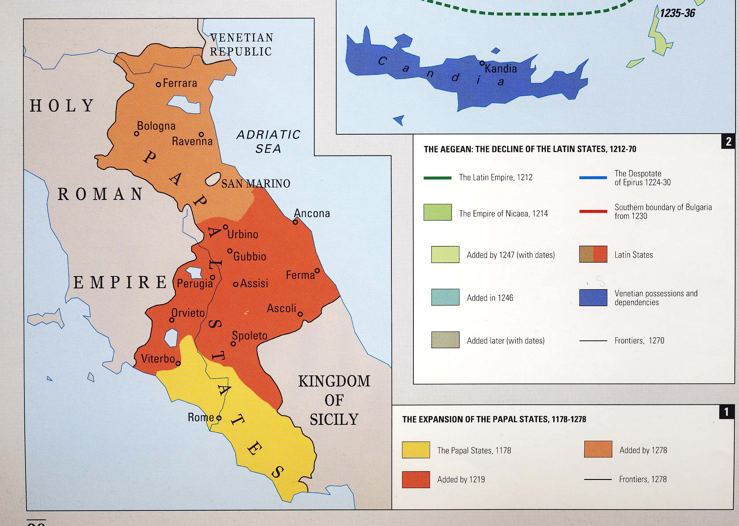
Notes:
Papal States also known as The Republic of St. Peter
Papal sovereignty over this territory lasted from 756-1870
Reached their greatest extent in the early 1500’s just before the Reformation

Slide 18
“I was considering the horns, and there was another horn, a little one, coming up among them....The ten horns are ten kings who shall arise from this kingdom. And another shall rise after them....”
–Daniel 7:8 and 24

Slide 19
The Little horn
Ten horns = Germanic tribes that rule the territories of the Western Roman Empire and become the powers of Europe
Little horn = the Papal States with the papacy as the “king”
  A little horn — small territory in comparison to other kingdoms
  But “greater than his fellows” — spiritual authority
  He rose after them — by the eighth century, the other kingdoms have been established
Notes:
Ten horns = Germanic tribes that rule the territories of the Western Roman Empire and become the powers of Europe
Little horn = the Papal States with the papacy as the king
A little horn — small territory in comparison to other kingdoms
But “greater than his fellows” — spiritual authority
He rose after them — by the eighth century, the other kingdoms have been established

Slide 20
Looks like a lamb, talks like a dragon

Slide 21
The dragon is behind both beasts
Both have seven heads and ten horns
13:4 - dragon gives authority to the first beast
13:11 - second beast speaks like a dragon
13:14 - “those signs which he was granted to do. . .” Granted by who?
Verse 15: “granted power to give breath to the image…” Granted by who?

Slide 22
“Let no one deceive you by any means; for that Day will not come unless the falling away comes first, and the man of sin is revealed, the son of perdition, who opposes and exalts himself above all that is called God or that is worshiped, so that he sits as God in the temple of God, showing himself that he is God…The coming of the lawless one is according to the working of Satan, with all power, signs, and lying wonders,”
–2 Thessalonians 2:3-4, 9
Notes:
Jesus won’t return until 2 things happen
An apostasy
The revealing of the man of sin
The man of sin
Opposes God — what do the first and second beasts do in Revelation 13? Make war against the saints, oppose those who won’t receive the mark of the beast
Exalts himself above all that is called God or that is worshiped

Slide 23
Review of Trumpet 6
1054, The Great Schism — West and East churches split
1057: the Seljuk Turks cross the Euphrates
1071: Byzantium defeated by the Seljuk Turks at Manzikert
1095: Byzantium close to collapse, emperor begs Pope Urban II to send aid immediately

Slide 24
“Most beloved brethren: Urged by necessity, I, Urban, by the permission of God chief bishop and prelate over the whole world, have come into these parts as an ambassador with a divine admonition to you, the servants of God…On this account, I, or rather the Lord, beseech you as Christ's heralds to publish this everywhere and to persuade all people of whatever rank, foot-soldiers and knights, poor and rich, to carry aid promptly to those Christians and to destroy that vile race from the lands of our friends. I say this to those who are present, it meant also for those who are absent. Moreover, Christ commands it. All who die by the way, whether by land or by sea, or in battle against the pagans, shall have immediate remission of sins. This I grant them through the power of God with which I am invested.”
–Pope Urban II, excerpt from speech at Clermont
Notes:
Pope Urban II speaks at Clermont
It has been called the most important speech of the Middle Ages
It was the call to the first of several crusades to rescue Palestine from the Muslim powers.
It signaled the end of the Dark Ages in Western Europe.
[CLICK] READ THE SPEECH
This speech galvanized Western Europe, especially the Franks, to carry out the First Crusade, a campaign motivated by the battle cry “God wills it!”

Slide 25
Implications
A call to arms in the name of Jesus Christ
He couches it as a command from God!
He offers the forgiveness of sins — remember Mark 2:5-11?
Spiritual and secular authority on full display
Revelation 13:6, “Then (the beast) opened his mouth in blasphemy against God, to blaspheme His name…”
Notes:
A call to arms in the name of Jesus Christ
Not a call to take the gospel to the followers of Muhammed
No, a call to “destroy that vile race."
He couches it as a command from God!
“Christ commands it!”
He offers the forgiveness of sins — remember Mark 2:5-11?
Mark 2:5-11 When Jesus saw their faith, He said to the paralytic, "Son, your sins are forgiven you." [6] And some of the scribes were sitting there and reasoning in their hearts, [7] "Why does this Man speak blasphemies like this? Who can forgive sins but God alone?" [8] But immediately, when Jesus perceived in His spirit that they reasoned thus within themselves, He said to them, "Why do you reason about these things in your hearts? [9] Which is easier, to say to the paralytic, 'Your sins are forgiven you,' or to say, 'Arise, take up your bed and walk'? [10] But that you may know that the Son of Man has power on earth to forgive sins"—He said to the paralytic, [11] "I say to you, arise, take up your bed, and go to your house."
Spiritual an secular authority on full display
“chief bishop and prelate over the whole world”
Revelation 13:6, “Then (the beast) opened his mouth in blasphemy against God, to blaspheme His name…”

Slide 26
“For such are false apostles, deceitful workers, transforming themselves into apostles of Christ. And no wonder! For Satan himself transforms himself into an angel of light. Therefore it is no great thing if his ministers also transform themselves into ministers of righteousness, whose end will be according to their works.”
–2 Corinthians 11:13-15
Notes:
Matthew 7:15 - Wolves in sheep’s clothing
Revelation 13:11 - Lamb talking like a dragon
Satan clothed as an angel of light

Slide 27
13:13-14
“He performs great signs, so that he even makes fire come down from heaven on the earth in the sight of men. [14] And he deceives those who dwell on the earth—by those signs which he was granted to do in the sight of the beast, telling those who dwell on the earth to make an image to the beast who was wounded by the sword and lived.”

Slide 28
He “performs great signs”
“…he even makes fire come down from heaven” — Genesis 19:24, 1 Kings 18:38, Luke 9:54
“…in the sight of the beast” or “in his presence” (verse 12) — working in tandem
  Second beast = papacy
  First beast = Catholic Church
“…few movements, to this day, that have claimed more signs and miracles to their endorsement….images have come down and lit their own candles…crucifixes have spoken; idols have sweat, turned their eyes, moved their hands, opened their mouths, healed sicknesses, raised the dead, mended broken bones….the stigmata has appeared on hands and feet of persons; Mary has appeared to many, healed their sicknesses, etc.” (Gregg, Revelation: Four Views)
Notes:
“He performs great signs”: Deceptive, he uses methods that appear supernatural to deceive.
“even makes fire come down from heaven” - A sign associated with God
Genesis 19:24, “Then the LORD rained brimstone and fire on Sodom and Gomorrah, from the LORD out of the heavens.”
1 Kings 18:38, “Then the fire of the LORD fell and consumed the burnt sacrifice, and the wood and the stones and the dust, and it licked up the water that was in the trench.”
Luke 9:54, “And when His disciples James and John saw this, they said, ‘Lord, do You want us to command fire to come down from heaven and consume them, just as Elijah did?’”
The sign appears to be from God, but it is, in fact, from Satan
“…in the sight of the beast” or “in his presence” (verse 12) — working in tandem
Second beast = papacy
First beast = Catholic Church
“…few movements, to this day, that have claimed more signs and miracles to their endorsement….images have come down and lit their own candles…crucifixes have spoken; idols have sweat, turned their eyes, moved their hands, opened their mouths, healed sicknesses, raised the dead, mended broken bones….the stigmata has appeared on hands and feet of persons; Mary has appeared to many, healed their sicknesses, etc.” (Gregg, Revelation: Four Views)

Slide 29
“The Church…resisted, then used, then abused, the cult of martyrs and relics. She opposed the worship of images and icons, and warned her faithful that these should be reverenced only as symbols; but the ardor of public feeling overcame these cautions, and led to the excesses that aroused the Byzantine iconoclasts. The Church denounced magic, astrology, and divination, but medieval, like ancient, literature, was full of them; soon people and priests would use the sign of the cross as a magic incantation to expel or drive away demons. Exorcisms were pronounced over the candidate for baptism, and total nude immersion was required lest a devil should hide in some clothing or ornament.”
–Durant, Age of Faith, p. 75
Notes:
Talked about the cult of martyrs in the last session — blasphemy of those in heaven
Gave into the public’s use of idolatry and images
Adopted superstitious practices with occult origins
Claimed — and still claims — to cast out demons

Slide 30
“The coming of the lawless one is according to the working of Satan, with all power, signs, and lying wonders…”
–2 Thessalonians 2:9
Notes:
God used signs to commend His servants to the world and confirm the legitimacy of their message
Pharaoh’s magicians demonstrate that such powers are not necessarily only within God’s province
The second beast was “granted to do” these signs
“Lying wonders” — they appear to be from God
He looks like a lamb but speaks like a dragon

Slide 31
Summary of 13:11-15
The papacy claimed to rule both the kingdom of heaven and the kingdoms of this world (a lamb with two horns)
The popes used both powers to conduct wars and commit atrocities in the name of Jesus Christ.
Lying signs and wonders led superstitious people to believe God backed both the papacy and the church.
Notes:
The papacy claimed to rule both the kingdom of heaven and the kingdoms of this world (a lamb with two horns)
The popes used both powers to conduct wars and commit atrocities in the name of Jesus Christ.
Lying signs and wonders led superstitious people to believe God backed both the papacy and the church.

